Slide 1
What Is VMs?

Slide 2
Virtualization

Slide 3
Virtual Machines

Slide 4


Why we need Virtual Machine?

Slide 5


Why we need Virtual Machine?
RAM, CPU, SDD
Hardware

Slide 6
Why we need Virtual Machine?
Windows OS
RAM, CPU, SDD
Hardware

Slide 7
Why we need Virtual Machine?
Applications
Windows OS
RAM, CPU, SDD
Hardware

Slide 8

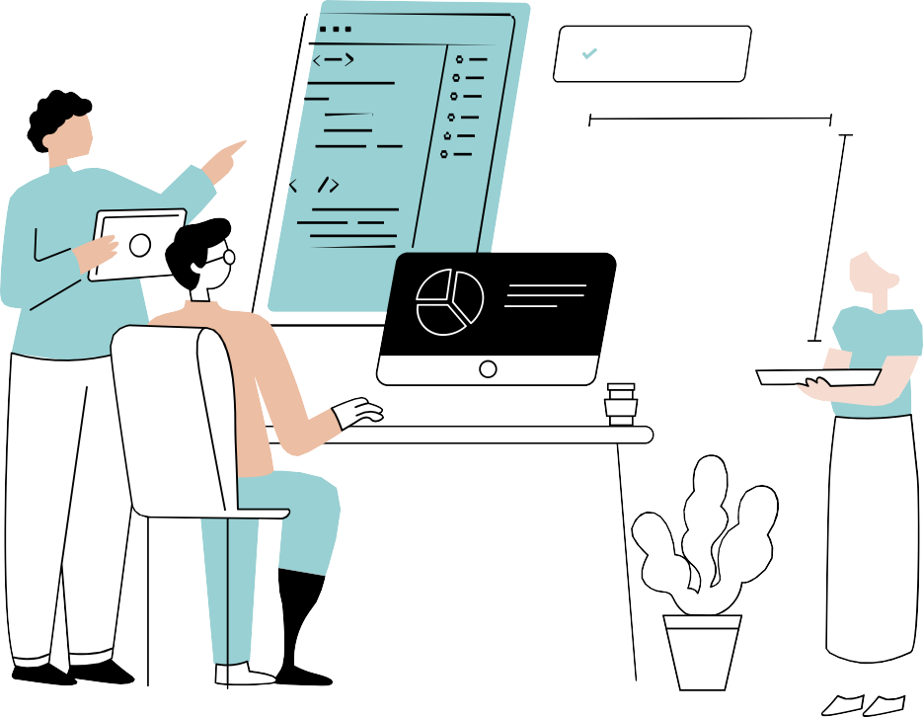

software

Slide 9





Why we need Virtual Machine?

Slide 10


Buy a new machine to run Linux?

Slide 11

No worries We have Virtualization

Slide 12

Windows
Hardware

Slide 13
Virtualization
Windows
Windows
Hardware

Slide 14





Linux OS
Virtualization
Windows
Windows
Hardware

Slide 15
















Windows
Windows
Linux OS
Virtualization
Virtualization
Virtualization
Linux
Mac OS
Windows
Hardware
Hardware
Hardware

Slide 16
But How to setup the Virtualization?

Slide 17
Hypervisor

Slide 18
Hypervisor
It is software that creates and runs virtual machines (VMs).

Slide 19











Hypervisor
HOST OS

Slide 20
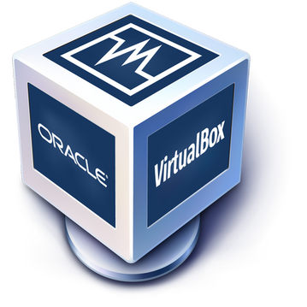








Hypervisor
HOST OS

Slide 21

How Hypervisor works?
Virtual box share hardware resources from Host OS
Separate set of virtual CPU, RAM, storage etc
VMs are fully isolated (independent of hosted OS)
Hypervisor

Slide 22
























VM1
2GB RAM
20 GB HDD
2GB RAM
10 GB HDD
VM2
8GB RAM
100GB HDD

Slide 23












Benefits of VMs
We don't need new resources to use different OS No risk of any issues with your primary OS
Testing any app on different OS

Slide 24
Types of Hypervisor
Type1(Bare Metal)
Type2 (hosted)

Slide 25
Hypervisor
HOST OS
Type 2 (Hosted)

Slide 26



















Type 1 (Bare-Matel)
Hypervisor
VMware vSphere / ESXi
Xen / Citrix XenServer
Hardware

Slide 27
Type 1 (Bare-Matel)
Used by Cloud Providers and Enterprise Servers.

Slide 28

Why do companies use virtualization?

Slide 29




Virtualization Use Case
Cheap Reduces
workload Space Energy
Easy backup using snapshot Easy recovery

Slide 30
Please Like & SUBSCRIBE
Thank
you!

Slide 31
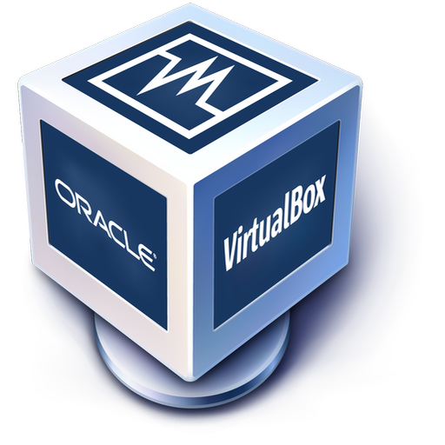
Linux VirtualBox Setup On Windows
Linux CentOs

